Slide 1
SMART RESTAURANT USING AI
Prepared By:
Fathimath Rumaisa K. H
Amrutha Balan
Krithi Rai K

Slide 2
Introduction :
Existing systems often lack personalized recommendations hindering
customer satisfaction and operational effectiveness. Our proposed
AI-enabled Smart Restaurant utilizes dynamic recommendations generated through Convolutional Autoencoder analysis. This innovative system
enhances customer satisfaction, ensuring optimal dining experiences and
driving business growth in the competitive hospitality sector.

Slide 3
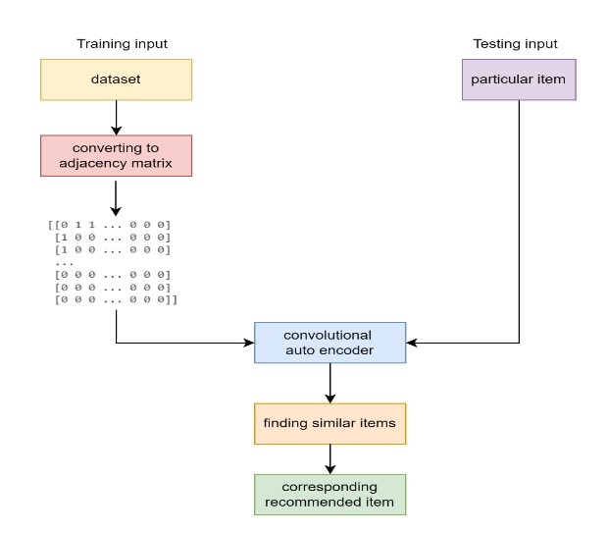
Methodology:
Figure: Methodology diagram

Slide 4
Convolutional Autoencoder (CAE):
convolutional autoencoder is an innovative approach that leverages deep learning techniques to capture complex patterns in user-item interactions.
Encoder:The encoder component compresses the high-dimensional adjacency matrix into a lower-dimensional feature space while preserving essential relational information.
Decoder:The decoder component reconstructs the original adjacency matrix from the learned low-dimensional representation, aiming to minimize the reconstruction error between the input and output
matrices during training.

Slide 5
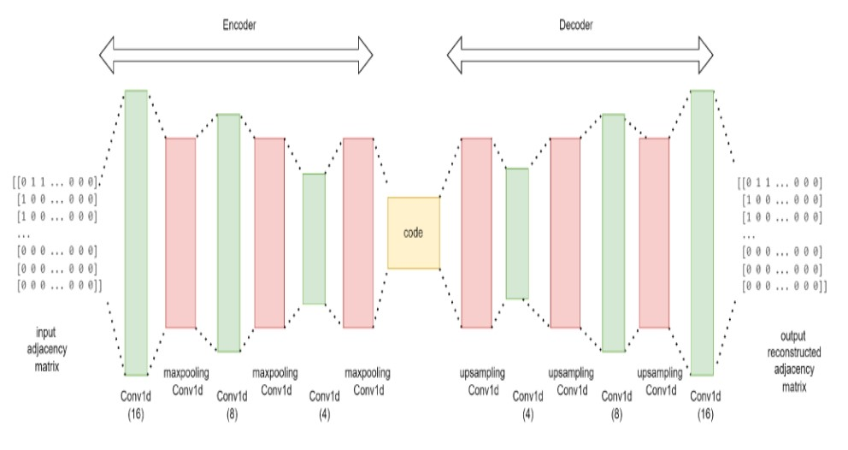
WORKING OF CONVOLUTIONAL AUTOENCODER:
Fig : Architecture of convolutional autoencoder

Slide 6
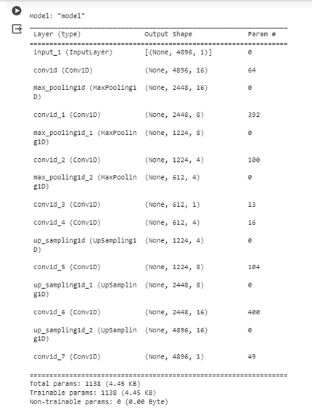
Summary of the model :
Fig : summary of the model

Slide 7
Webpage:
Our smart restaurant webpage likely features a login page where user can authenticate themselves, accessing features such as personalized recommendations. The menu page would likely showcase restaurant’s offerings with price. Our webpage aims to provide a convenient and enjoyable way for customers to explore restaurant’s offerings.

Slide 8
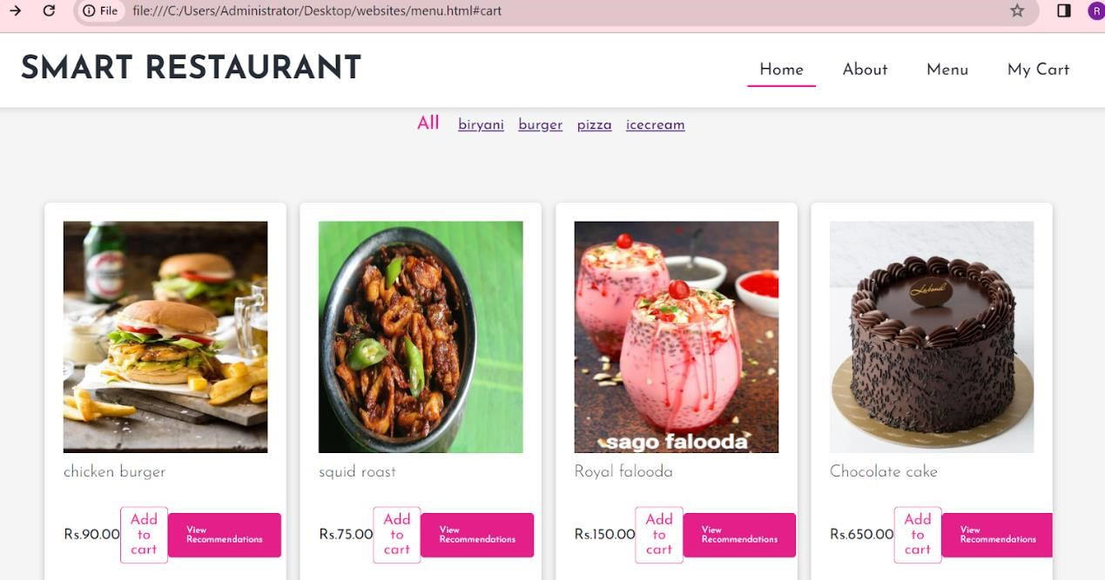
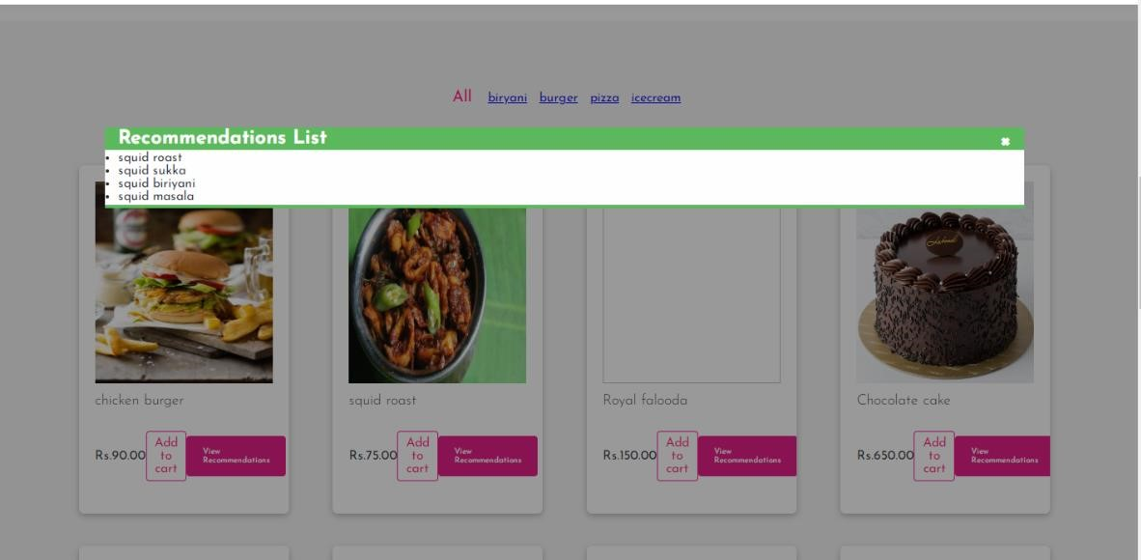

Slide 9
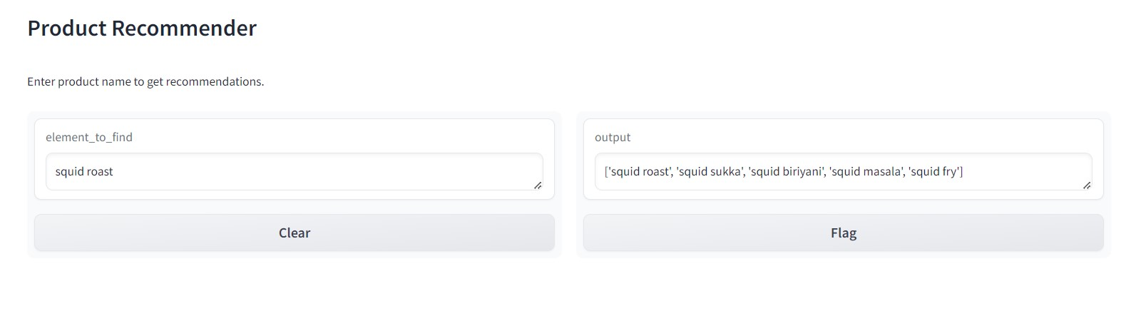
Implementation :
Gradio :
Gradio is used for developing the graphical user interface. Here a GUI is developed using gradio which takes an image as input, then calls the predict function provided for prediction based on our model and gives the class name as output.

Slide 10
Conclusion :
Crafting a groundbreaking dining experience, our Smart Restaurant project pioneers the integration of AI to deliver personalized recommendations.
Used convolutional autoencoder technology for recommendations. In today's fast-paced world, where personalized experiences are valued, our project stands as a beacon of innovation, showcasing the transformative power of AI in enhancing everyday interactions and shaping the future of dining.

Slide 11
References :
Zhang, Su-Zhi, Peng-Hui Li, and Xiao-Ni Chen. "Collaborative Convolution AutoEncoder for Recommendation Systems." Proceedings of the 2019 8th International Conference on Networks, Communication and Computing. 2019.
2. Xue, G., Liu, S., & Ma, Y. (2020). A hybrid deep learning-based fruit classification using attention model and convolution autoencoder. Complex & Intelligent Systems, 1-11.

Slide 12
THANK YOU

